Slide 1
PnP Community Call – November 2014
aka.ms/OfficeDevPnP
aka.ms/OfficeDevPnPYammer
PnP Core Team

Slide 2




Agenda
Let’s get started
Contributions and process
Other topics
Roadmap and next steps

Slide 3
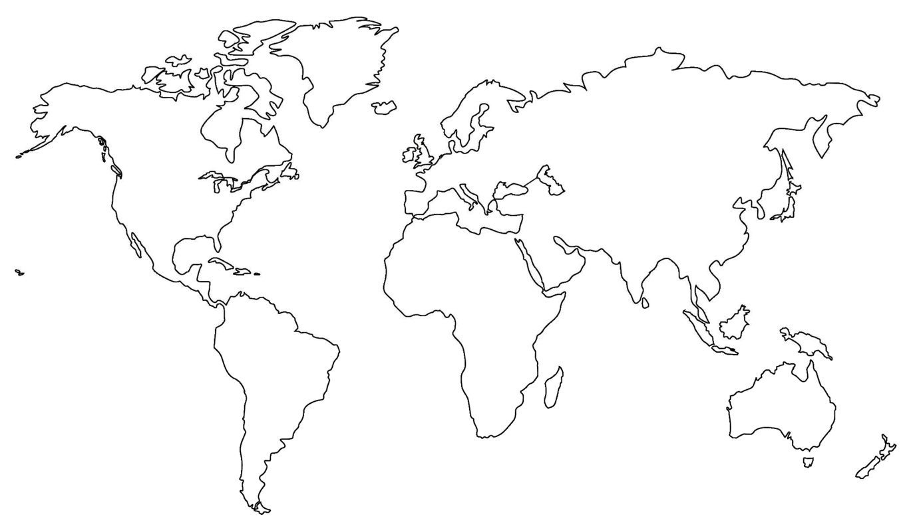
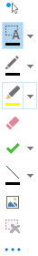
Where are you located?
Stamp Tool
Notes:
Length: 2 minutes for this slide
This slide is a quick demo/practice of the “Stamp” tool and how to use it during course interactions.
Have students Check where they live.
If it’s a small class, have students type their name where they live.
Reach out to the farthest away student

Slide 4


Developer
Patterns & Practices
aka.ms/OfficeDevPnP
aka.ms/OfficeDevPnPYammer

Slide 5
Statistics– Key numbers (previous month)
Forked 135 times (98)
189 merged pull requests (128)
43 closed issues (29)
More than 2160 (1899) unique visitors during last 2 weeks
Yammer group has 757 members (587)
aka.ms/OfficeDevPnPYammer

Slide 6
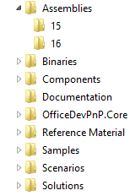
PnP Structure – folders and code
All referenced assemblies are included in package.
Contains latest 15 & 16 versions of the CSOM components.
No need for additional downloads
Reusable components targeted for reuse as such in projects.
Various Presentations on different scenarios.
Reusable remote operation component with extensions methods to standard CSOM objects.
Sample projects. Independent samples demonstrating a capability or functionality.
Scenario demonstrations for the usage of the core component. Contains additional explanations and usage models for API patterns.
Complex reusable solutions demonstrating combining multiple capabilities for building real solution. Uses core component.

Slide 7

Thank you for your assistance!
Erwin Van Hunen (Knowit AB) @erwinvanhunen
Sly Gryphon (Readify) @sgryphon
Henrik Gustafsson (HappySolutions) @SharePointHenke
Cory Peters @cory_peters
Dan Budimir (Microsoft)
Stijn Neirinckx
Luis Valencia @levalencia
Paolo Pialorsi (PiaSys.com) @PaoloPia
Koen Zomers (Microsoft) @KoenZomers
Bruce Albany (Ensyst) @BruceAlbany
Core team – Frank Marasco, Bert Jansen, Vesa Juvonen, Brian Michely, Suman Chakrabarti, Steve Walker

Slide 8
New samples and scenarios
Core.DocumentPicker (Stijn Neirinckx)
Core.JSOM.Minicalendar (Luis Valencia)
Core.Services.Authenticate (Bert Jansen, Microsoft)
Provisioning.SiteModifier (Erwin Van Hunen, Knowit AB)
Workflow.CustomEvents (Paolo Pialorsi, PiaSys.com)
UserProfile.Manipulation.CSOM (Vesa Juvonen, Microsoft)

Slide 9
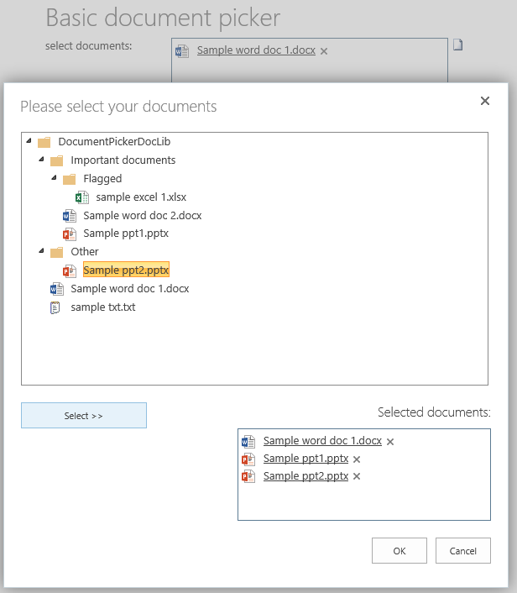
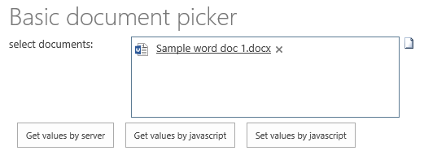
Core.DocumentPicker (Stijn Neirinckx)
Document picker for provider hosted apps
Point to host web library for selecting documents

Slide 10
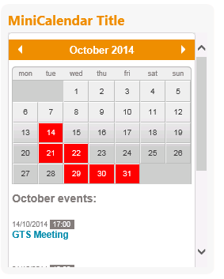
Core.JSOM.Minicalendar (Luis Valencia)
SharePoint Hosted app for showing calendar information
http://www.luisevalencia.com/2014/10/31/how-to-create-a-very-nice-minicalendar-apppart-to-render-your-events-sharepoint-hosted-app

Slide 11
Core.Services.Authenticate (Bert Jansen, Microsoft)
How you can call Web API 2 services from low trust provider hosted SharePoint apps.
You'll have the option to authorize the Web API call and to "reinstantiate" the callers client context in the WebAPI service. We'll also address how to make cross domain calls to WebAPI services.
Inspired by the CloudTopia sample of Steve Peschka

Slide 12
Provisioning.SiteModifier (Erwin Van Hunen, Knowit AB)
This scenario demonstrates how an app can be used to provide a dialog box in which users can make selections of artefacts to be added to the site the moment they need it.
This scenario demonstrates the following:
How to add a custom action to the site settings menu in the host web (see Services\AppEventReceiver.svc)
How to show a dialog in a custom action (see Services\AppEventReceiver.svc)
How to hide a dialog that hosts a page from a remote app web (see Pages\Modify.aspx)
How to create artefacts like lists and set the theme of a web (see Pages\Modify.aspx)

Slide 13
Workflow.CustomEvents (Paolo Pialorsi, PiaSys.com)
This SharePoint-hosted sample application for SharePoint demonstrates how to create a workflow that waits for a custom event, which will be raised by a custom Page via JavaScript and using the JavaScript Client Object Model (JSOM) for the Workflow Services Manager library

Slide 14
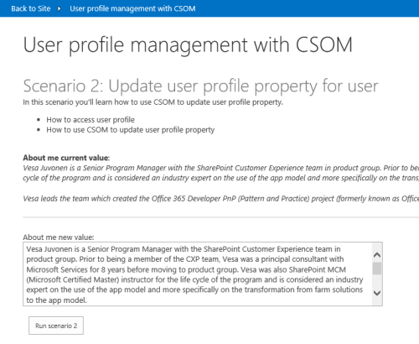
UserProfile.Manipulation.CSOM (Vesa Juvonen, Microsoft)
Shows how to use CSOM to update user profile properties
New properties in the user profile CSOM after the September release, which are now also available in the server side

Slide 15
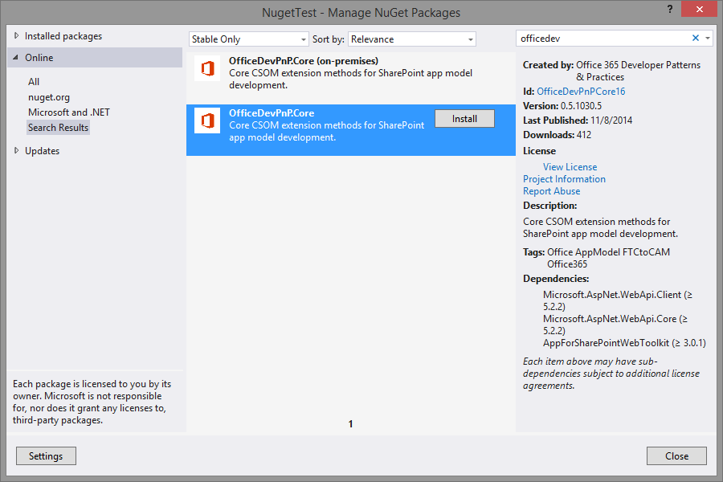
Nuget Package is out!
PnP Nuget Packages are out!
Separate packages for cloud and on-premises
15 & 16 version of the CSOM
Currently compiled from the dev branch during 8th of Nov
Will be updated during master merges

Slide 16
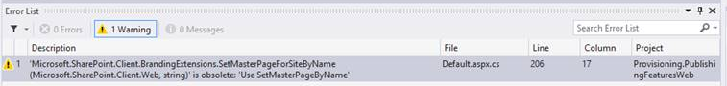
Updates to PnP Core and miscellaneous
Lots of refactoring, updates and improvements done and more to be introduced later
No breaking changes with any updates like in the past, just guidance in VS to drive to right direction
Old methods do work as well, but we indicate changes with obsolete messages
Improvements in unit tests ➔ 95 unit tests available!

Slide 17
Master merge
We are planning to perform master merge next week to sync up things again
More detailed testing will be done before this one
In general we are moving to monthly master branch releases from this moment forward

Slide 18
How to contribute?
Documentation in wiki
https://github.com/OfficeDev/PnP/wiki/contributing-to-Office-365-developer-patterns-and-practices
Simple steps
Fork
Apply changes and contributions
Submit a pull request
Core team members will review
Merged to Dev

Slide 19

Roadmap – What’s coming?
New patterns for SP side
Starter kits
Provisioning
Remote timer jobs
Improvements to core component
Unit testing, logging, other stuff
Guidance
Application Life Cycle for app model
Design patterns for App model based implementation
Transformation guidance for existing customizations
App model impact for enterprise architecture
Content migration for app model implementation
Continuous integration

Slide 20
Feedback…
Please keep the feedback coming in Yammer… we need your input for the prioritization.
Notes:
Priority on planned topics
More code samples
Add core component capabilities
Reusable presentation material
Documentation on patterns and practices for app model (ALM ec.)
More complex solutions
More Office Client apps
More JavaScript app
Length: 30 second for this slide
Instructor notes
The following slides will walk you though the Lync tools that we will use in this class.
You will use all of these tools later in the class
Stress that your students will be able to run much more engaging meetings if they use these tools in their own Lync Meetings.
Course Development Notes:

Slide 21
Transform your code Providing App Model Patterns for common Full Trust Code scenarios
50+ Visual Studio projects Common scenarios
Branding
Site provisioning
Remote event receivers
Large file support
Taxonomy driven navigation
And much more…
Contribute
This is open source project and open for contirbutions
Developer
Patterns & Practices
aka.ms/OfficeDevPnP

Slide 22

Questions?

Slide 23


© 2014 Microsoft Corporation. All rights reserved. Microsoft, Windows, and other product names are or may be registered trademarks and/or trademarks in the U.S. and/or other countries.
The information herein is for informational purposes only and represents the current view of Microsoft Corporation as of the date of this presentation. Because Microsoft must respond to changing market conditions, it should not be interpreted to be a commitment on the part of Microsoft, and Microsoft cannot guarantee the accuracy of any information provided after the date of this presentation. MICROSOFT MAKES NO WARRANTIES, EXPRESS, IMPLIED OR STATUTORY, AS TO THE INFORMATION IN THIS PRESENTATION.

